Slide 1
Plumbing Merit Badge
Troop 344 and 9344
Pemberville, OH

Slide 2
Plumbing Merit Badge Requirements
Do the following:
Describe how a properly working plumbing system protects your family's health and safety.
List five important local health regulations related to plumbing and tell how they protect health and safety.
Describe the safety precautions you must take when making home plumbing repairs.
Do the following:
Make a drawing and explain how a home hot- and cold- water supply system works. Tell how you would make it safe from freezing.
Make a drawing and explain the drainage system of the plumbing in a house. Show and explain the use of drains and vents.

Slide 3
Plumbing Merit Badge Requirements
Show how to use five important plumber's tools.
Identify and describe the use of each of the following: washer, retaining nut, plunger (rubber force cup), solder, flux, elbow, tee, nipple, coupling, plug, union, trap, drainpipe, and water meter.
Name the kinds of pipe that are used most often in a plumbing system. Explain why these pipes are used.
Cut, thread, and connect two pieces of metal pipe.
Under the supervision of a knowledgeable adult, solder three copper tube connections using a gas torch. Include one tee, two straight pieces, and one coupling.
Do the following:
Replace a washer in a faucet.
Clean out a sink or lavatory trap.

Slide 4
Requirement 1
Do the following:
Describe how a properly working plumbing system protects your family's health and safety.
List five important local health regulations related to plumbing and tell how they protect health and safety.
Describe the safety precautions you must take when making home plumbing repairs.

Slide 5
1a. Protecting Health and Safety
For the health and safety of the people who live there, the water entering the home through the water-supply system must be pure and clean.
Wastewater and sewage being carried away from the home by the way of the drainage system may contain bacteria, viruses, and fungi that can cause serious disease and set off allergies and should never come into contact with the water that the family uses for drinking, bathing, or washing clothes and dishes.

Slide 6
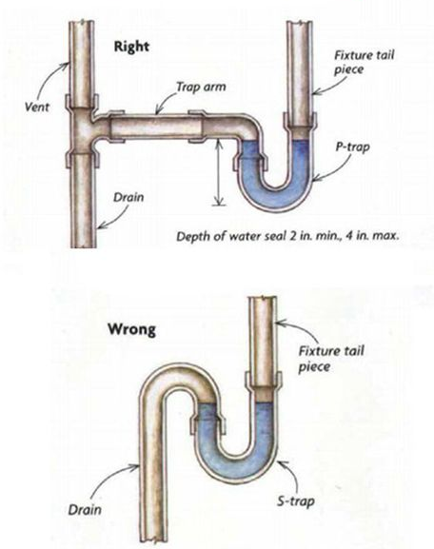
1b. Five Important Health Regulations
All drains require a P trap to keep sewer gas out of structure.
Vents are required to keep the P trap from being siphoned.
Where potable (drinking) water will enter a source of contamination such as outside, dentist office, doctor's office, machinery, an approved check valve, back flow preventer must be installed.
Pipes passing through walls shall be protected from breakage by nails or screws.
A temperature and pressure relief valve must be installed on a water heater to prevent excessive pressure build-up and possible explosion.

Slide 7
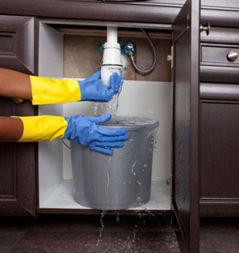
1c. Safety in Plumbing Repairs
Turn the water supply off before you start.
Call a professional for anything other than the most basic plumbing problems.
Protect the area where you are working before you start, because you probably will spill some water.
Protect chrome finishes with a cloth pad while you work.
Wear protective gloves and goggles to avoid injury to the skin and eyes when using chemical drain cleaners to unclog a drain.
Keep power tools away from areas where water has leaked to avoid shock hazards.
Repair all leaks immediately. Otherwise mold or other growths may contaminate the entire household.

Slide 8
Requirement 2
Do the following:
Make a drawing and explain how a home hot- and cold- water supply system works. Tell how you would make it safe from freezing.
Make a drawing and explain the drainage system of the plumbing in a house. Show and explain the use of drains and vents.

Slide 9
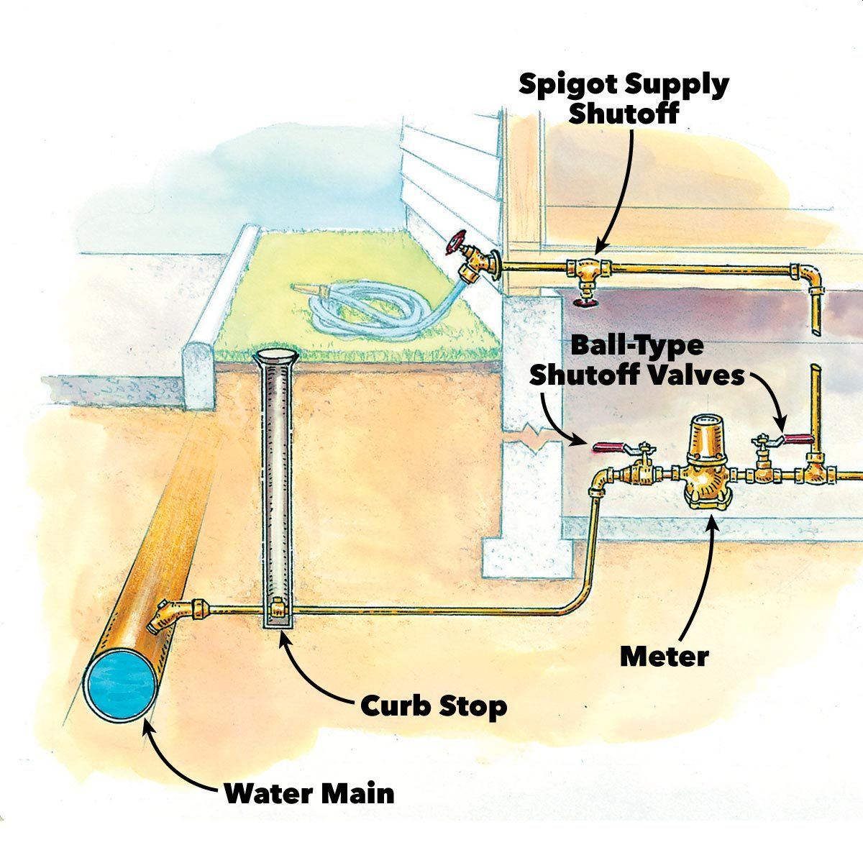
2a. Home Water Supply
The supply system brings clean water into a home and may come from a private well or from a municipal source.
It is important to know how to shut off the water supply to your home in case of emergency.
Supply water is always under pressure and if a leak or break occurs, water will flow out of the pipe and possibly cause flooding.
Typically, where water enters the house, there will be a ball-type main shutoff valve.
There are lots of smaller shutoff valves throughout your home to help isolate a leak.
i.e. under the sink, beside the toilet.

Slide 10
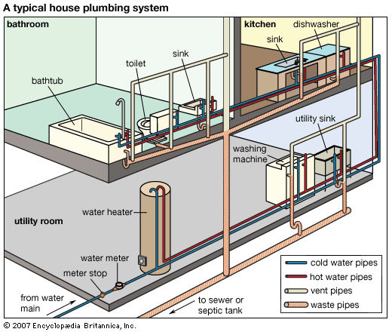
2a. Home Hot and Cold Water Supply
Water enters your house through the service pipe.
Inside your house, the service pipe branches off to supply cold water to fixtures and appliances, including the hot-water heater.
From the hot-water heater, pipes branch off to supply hot water to the places it is needed, such as sinks, bathtubs, and washing machines.

Slide 11
2a. Frozen Pipe Prevention

Slide 12
2a. Safely Thawing Pipes
Turn off the water to the frozen pipe by using the appropriate shutoff valves.
Open the faucet that the frozen pipe supplies so that the steam that will form when you heat the pipe can escape.
Use a hair dryer to thaw the pipe.
Do not get the pipe so hot that you cannot touch it.
Keep the hair dryer moving.
After you have thawed a pipe, check it visually for cracks and leaks.

Slide 13
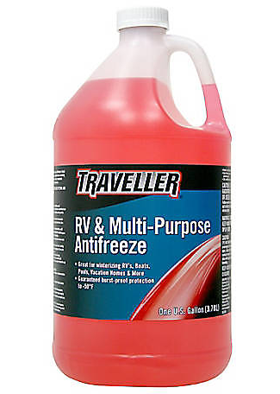
2a. How to Winterize Plumbing
An adult should turn off the power to the water heater and then drain it.
Shut off the main water valve, then open the drain valve at the lowest point in the water system.
Open all faucets to allow air to enter the pipes from above.
Detach the flexible hoses on dishwashers and washing machines.
If the house has a pumping system, carefully drain the pressure tank and the pump itself.
Treat all the traps in the house so that they will not freeze by putting a solution of antifreeze made especially for RV’s.
Toilet tanks should be flushed empty before the antifreeze is added to the water in the bowl.

Slide 14
2b. Home Drain Pipe System
The drain pipe system uses gravity to carry waste and water away from your home.
The drain pipes are larger in diameter than supply pipes and have gentle bends so that waste can move freely.
The system includes cleanouts and traps; places that clogs can be cleared with a “snake” or auger.
The waste stack is vertical and usually 3” or 4” in diameter.
Toilets must drain directly into the waste stack.
Sinks and bathtubs may use branch pipes that slant downward into the waste stack at no less than ¼” per foot.
The waste stack connects to the main house drain (usually just beneath the basement floor in in the crawl space under the house).
It runs at a downward slope to the septic system or to a sewer main.

Slide 15
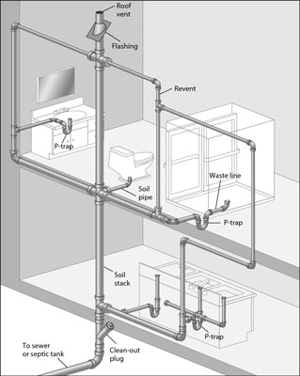
2b. Home Drain Pipe System
Plumbing systems must have air vents to allow the free passage of waste from fixtures.
Vent pipes allow fresh air to pass throughout the plumbing system to prevent loss of water from traps due to siphoning.
Vents also allow sewer gas to pass out safely above the level of open windows and people.
Sewer gas is poisonous and can cause explosions.
The main vent is an extension of the soil pipe.

Slide 16
Requirement 3
Show how to use five important plumber's tools.

Slide 17
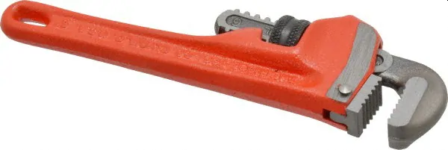
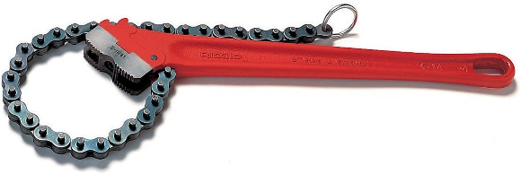
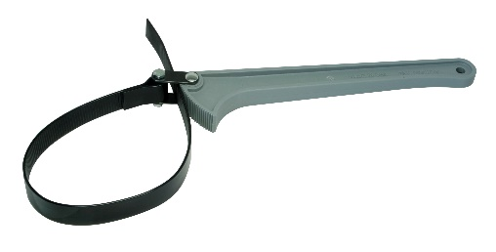
3. Wrenches
Pipe Wrench – Designed to grip and turn a pipe. Its teeth bite into the pipe and hold it firmly.
Chain Wrench – Good for heavy work. It can grip pipes in hard to reach places and has considerable leverage.
Adjustable Wrench – Works well to tighten and loosen the nuts on faucets and other fixtures.
Basin Wrench – Used to tighten hard to reach nuts behind sinks.
Strap Wrench – Good for chrome and plastic pipes because it will not mar their surfaces.

Slide 18
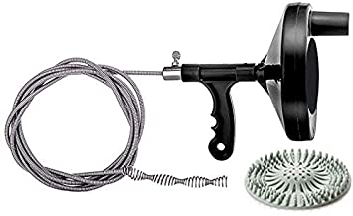
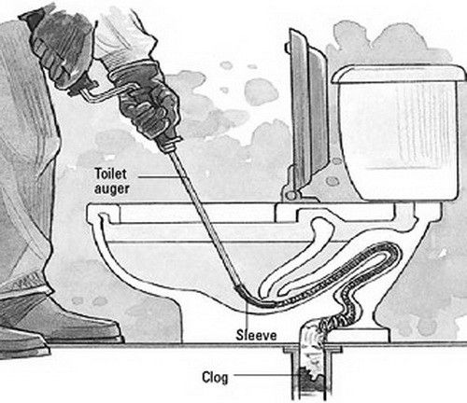
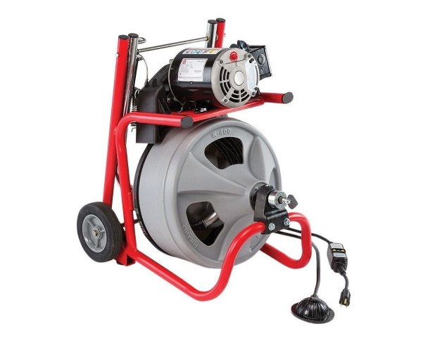
3. Augers
Plumber’s Auger (Snake) – A flexible ribbon or coil of spring steel that can be used to clean out plugged drains and traps.
Closet Auger – Made for clearing toilets.
Commercial Auger – A power-driven device for cleaning out a badly clogged waste stack.

Slide 19
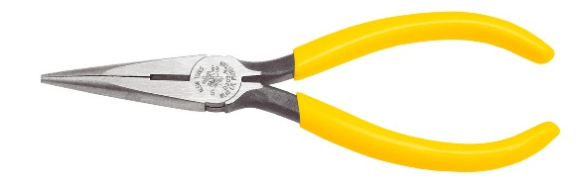
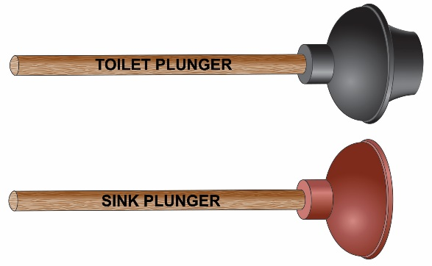
3. Other Plumbers Tools
Needle-Nose Pliers – Used to remove O-rings and clips of faucets.
Tongue-and-Groove Pliers – can be adjusted to grip many different sizes of pipe.
Plunger – Can be used to clear plugged drains, particularly those in toilets.
Level – Helps plumbers make sure that the components of the drainage system are properly sloped downhill.
Pipe Cutter – Gradually cuts as it is turned around the pipe.

Slide 20
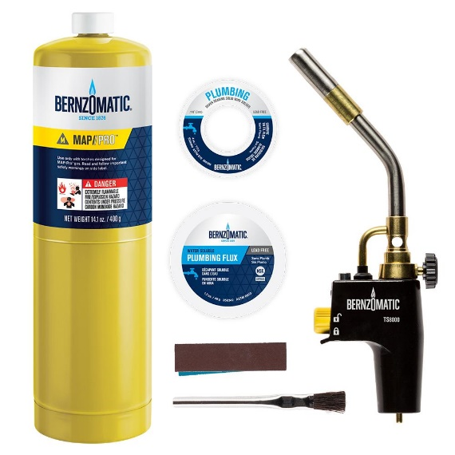
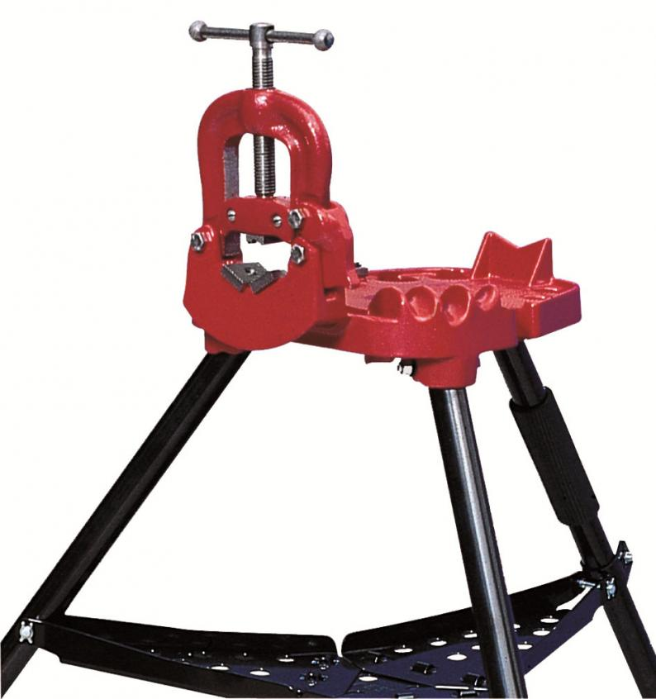
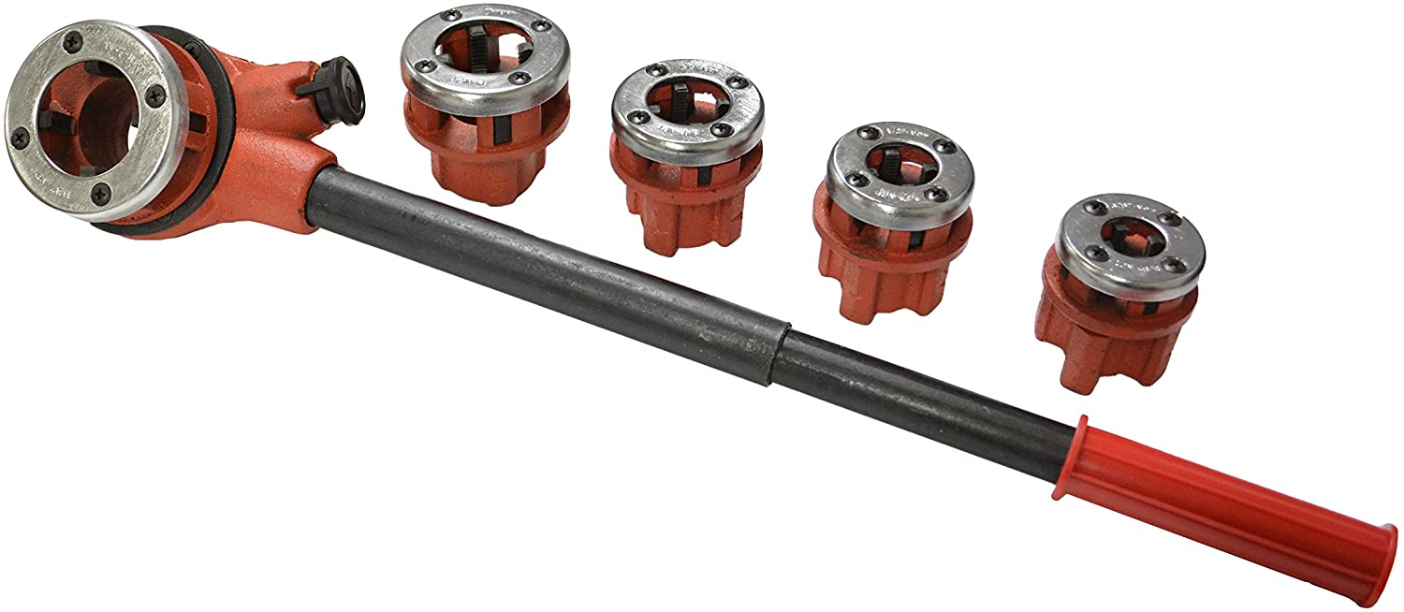
3. Other Plumbers Tools
Portable Gas Torch – Used for soldering copper pipe.
Pipe Vise – Bolted to a workbench or tripod, is used to hold steel pipe for cutting, reaming, and threading.
Threading Dies – Used for cutting threads onto steel pipe.

Slide 21
Requirement 4
Identify and describe the use of each of the following: washer, retaining nut, plunger (rubber force cup), solder, flux, elbow, tee, nipple, coupling, plug, union, trap, drainpipe, and water meter.

Slide 22
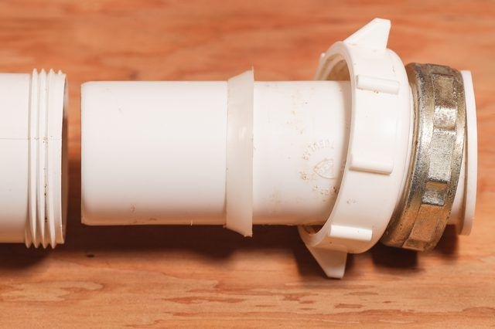
4. Washer and Retaining Nut
A slip joint is a simple but efficient way to seal against leaks.
If you look under your kitchen or bathroom sink, you'll probably see one with a plastic or metal slip nut (retaining nut).
Beneath that metal slip nut is a rubber or PVC washer.
The washer is compressed as the slip nut is tightened, forming a seal against leaks.

Slide 23
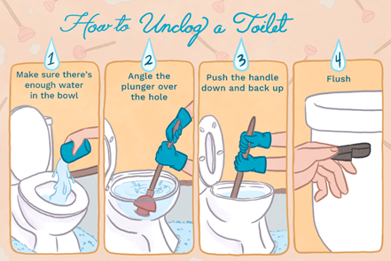
4. Plunger
When the plunger is pressed down, over a clog, it forces air into the drain and increases pressure.
When the clog is moved, the air will continue to move through the pipes.
Pulling back up on the plunger creates a vacuum and forcing anything in the pipe upwards and out.

Slide 24
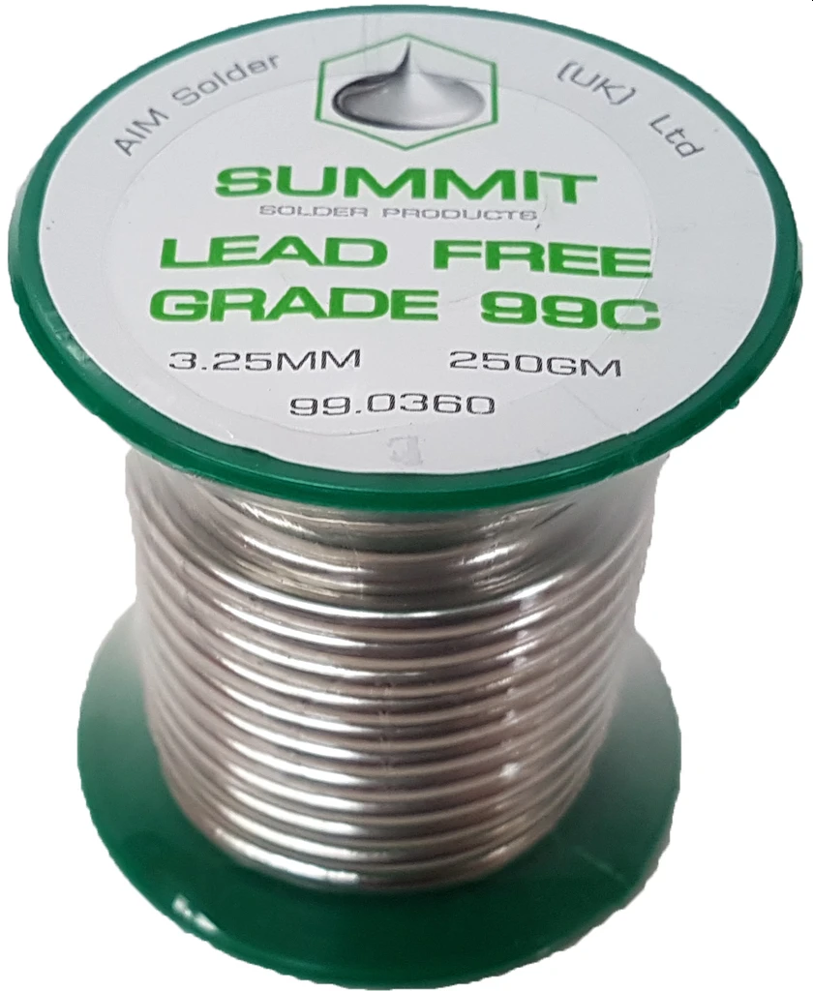
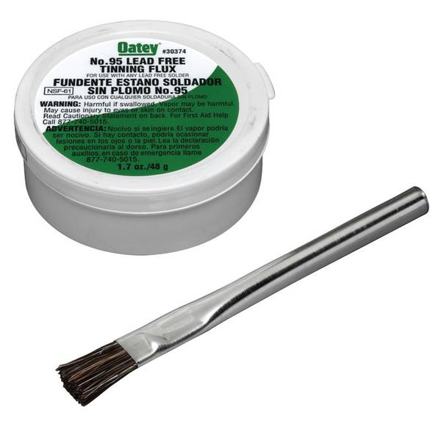
4. Solder and Flux
Plumbers use a metal filler called solder, which can be melted to join two pieces of metal.
Solder is an allow of tin and other metals that melts at a lower temperature than the pieces of metal being joined.
Only use lead free solder for plumbing.
Flux is a substance used to remove any oily film or dust that might keep the solder from uniting with the metal. Flux also removes oxides and prevents further oxidation while the metal is heated to the soldering temperature.

Slide 25
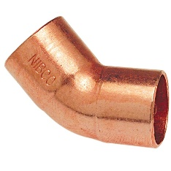
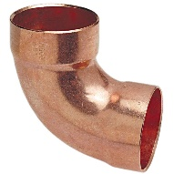
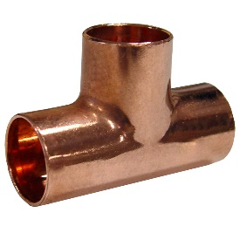
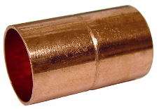
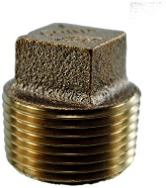
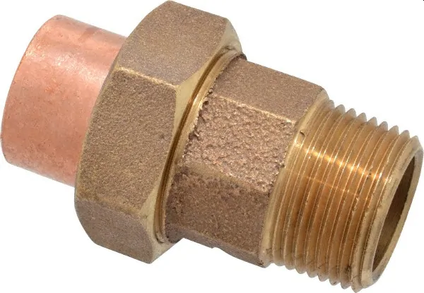
4. Elbow, Tee, Nipple, Coupling, Plug, Union
Elbow (El) – Used to change the direction a supply pipe is going and usually have a 45 or 90 degree angle.
Tee – Used to join two pipes that intersect at a right angle.
Nipple – Short piece of pipe with threads on both ends and are used to join fittings.
Coupling – Connect pipes in a straight line.
Plug – A threaded fitting used at the end of a pipe to close it.
Union – A fitting that allows you to disconnect a pipe without having to cut it.

Slide 26
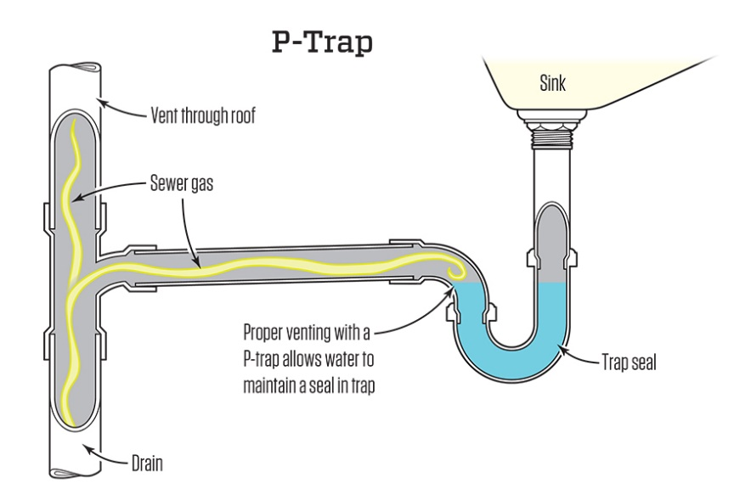
4. Trap and Drainpipe
Under every plumbing fixture there is a special fitting called a trap.
Water rests in the trap and is called a water seal.
The water seal permits liquids and solids, but not air, to pass through the pipe.
Without water in a trap, toxic and explosive sewer gas can enter the building.
Every time water travels down the drain, new water replaces it in the trap, forming another seal

Slide 27
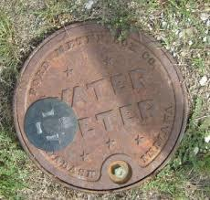
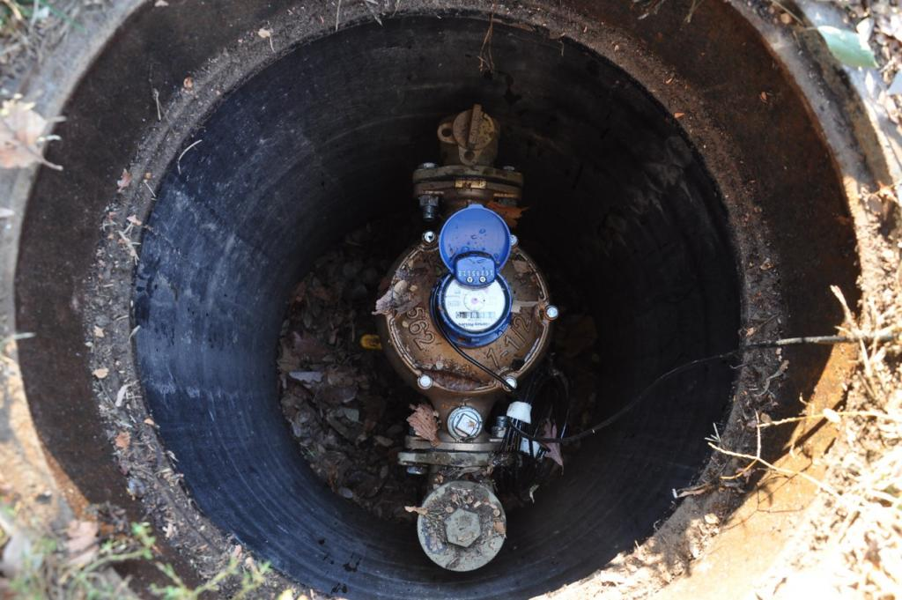
4. Water Meter
If you get your water from a municipal source, a large pipe called a water main runs near your house.
Between the main and your home is a water meter which keeps track of the amount of water you use.
If you use a private well, you do not have a meter.

Slide 28
Requirement 5
Name the kinds of pipe that are used most often in a plumbing system. Explain why these pipes are used.

Slide 29
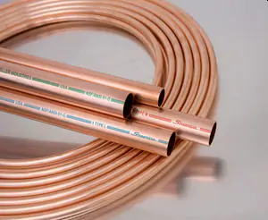
5. Types of Plumbing Pipes
Copper is one of the most traditional materials for plumbing pipes.
Copper pipes advantages include:
Longevity: Copper has proven to be a reliable material that can last at least 50 years.
Durability: Copper is a sturdy material that is not prone to leakage or corrosion.
Safety: Bacteria cannot thrive in copper pipes, and copper will not pollute water in any way, so it is safe to transport drinking water.
Disadvantages of copper pipes include:
Financial Cost: The main deterrent to using copper is the cost.
Environmental Cost: Environmentally-conscious homeowners may be concerned about the fact that copper mining and manufacturing take a toll on the environment. So, although copper pipes last a long time and can be recycled, they are not considered a "green" product.

Slide 30
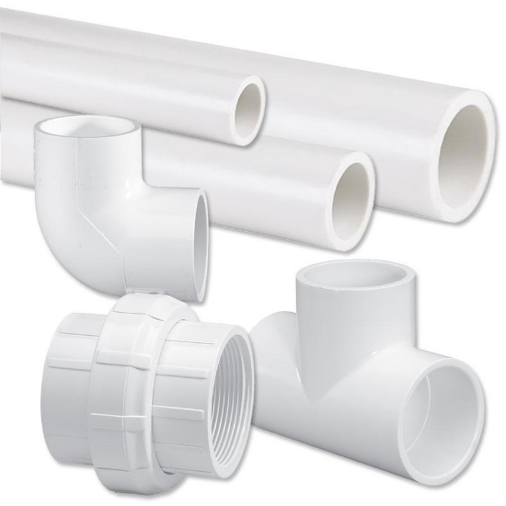
5. Types of Plumbing Pipes
Polyvinyl chloride, more commonly known as PVC, has become a popular choice for plumbing pipes.
PVC pipes advantages include:
Longevity: PVC is not subject to rust or corrosion, so unless it experiences some sort of unexpected damage, it can last indefinitely. Even the most durable metals used in plumbing pipes cannot live up to the impressive lifespan of PVC.
Ability to Handle Pressure: PVC is often used for the main supply line that goes into your home because it is able to handle high water pressure.
Ease of Use: PVC is extremely light compared to metal pipes, which makes it easy to transport and to work with. It is also easy to work with because there is no soldering required to connect pipes. Instead, pipes are essentially glued together.
Low Cost: PVC is low in cost as well. Especially compared to copper, PVC is a very inexpensive option for plumbing pipes.
Disadvantages of PVC pipes include:
PVC is not equipped to transport hot water: Heat can cause the material to warp and melt.

Slide 31
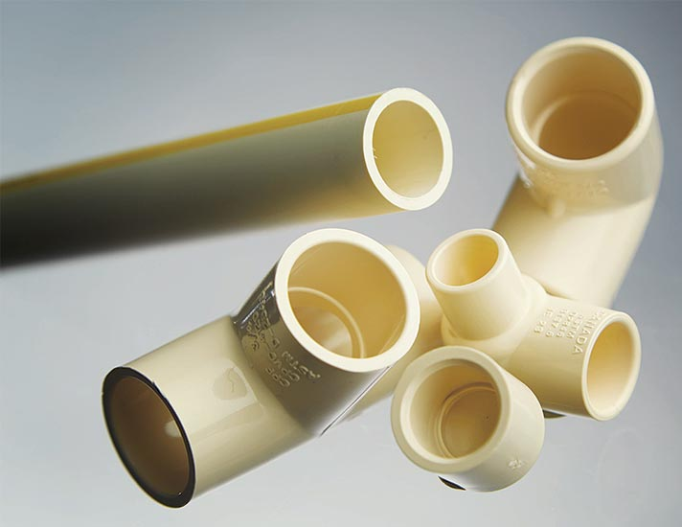
5. Types of Plumbing Pipes
Chlorinated Polyvinyl Chloride, shortened to CPVC.
CPVC pipes advantages include:
Longevity: Like PVC, since CPVC is a plastic material, it does not react to corrosive substances and does not rust, so its lifespan is indefinite.
Ability to Handle Pressure: CPVC shares PVC's ability to handle high water pressure, making it a good material for a main water supply line.
Ease of Use: CPVC is also quite lightweight, which makes it easy to move and work with. CPVC is also somewhat flexible.
Low Cost: Though CPVC costs more than PVC, it is still a budget option compared to metal piping materials.
Temperature Tolerance: CPVC is able to withstand extreme temperatures up to 200 degrees Fahrenheit. This equips CPVC to handle hot water transport.
Disadvantages of CPVC pipes include:
Indoor Application Only: CPVC is vulnerable to breaking down if exposed to sunlight for extended periods of time.

Slide 32
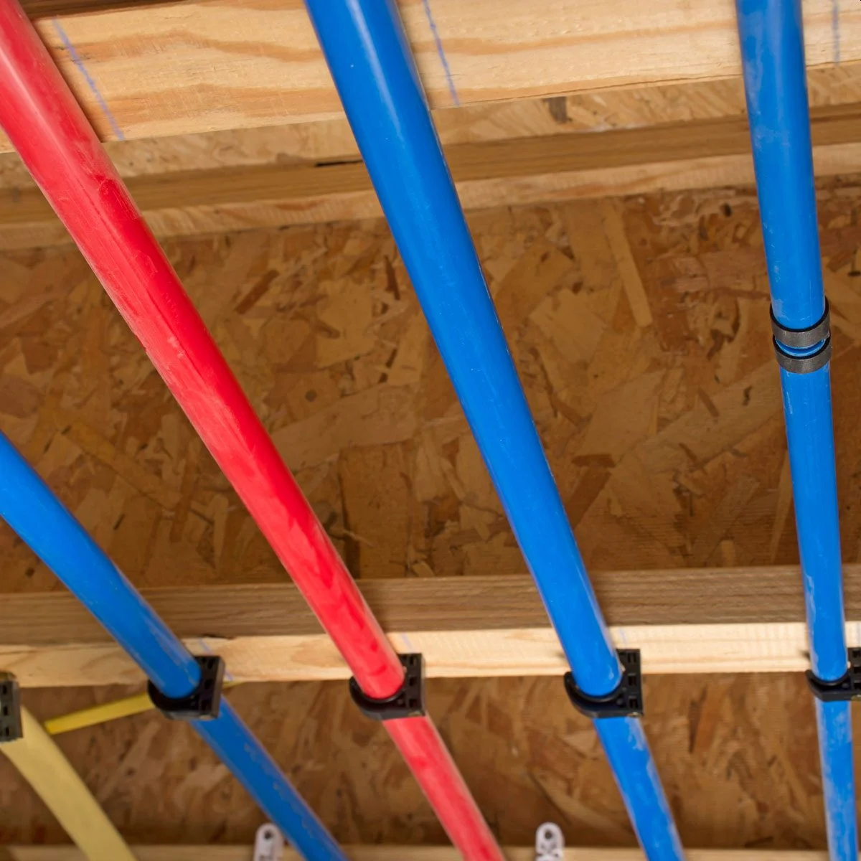
5. Types of Plumbing Pipes
Cross-Linked Polyethylene, or PEX for short, is another plastic material used for piping.
PEX pipes advantages include:
Longevity: PEX pipes are completely rust and corrosion resistant. This means they can last indefinitely without needing to be replaced, unless they are broken somehow.
Flexibility: PEX is flexible enough to make 90-degree turns with no problem. It can easily be snaked into walls — making it a great material for retrofitting — and it is able to extend across the length of a house with just one long piece.
Ease of Use: PEX's flexibility makes it very easy to install. When joints are needed, no soldering or even gluing is required.
Temperature Tolerance: PEX is able to withstand extreme temperatures. It can be used to transport hot water as well as cold.
Low Cost: PEX is significantly cheaper than copper.
Disadvantages of PEX include:
Indoor Application Only: PEX piping can be damaged by UV radiation.

Slide 33
Requirement 6
Cut, thread, and connect two pieces of metal pipe.

Slide 34
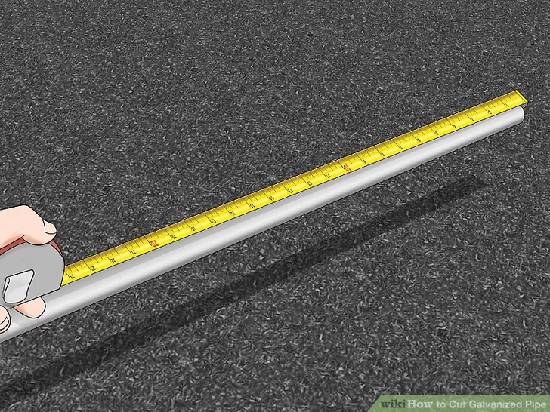
6. Cut, Thread, and Connect Metal Pipe.
Measure for your cut.
Making a precise cut is important when installing new galvanized pipe.
For example, if you are planning on threading your pipe, you need to take the length required for adding threads to the ends of the pipe into consideration when marking your cuts.

Slide 35
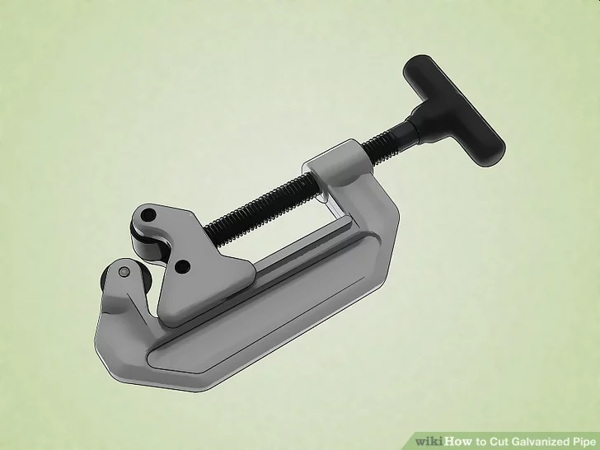
6. Cut, Thread, and Connect Metal Pipe.
Tube cutters are often used by plumbers for cutting copper and steel pipe they are installing or removing.
Tube cutters come in a variety of sizes. Each cutter will typically cut a range of sizes.
Rotate the tube cutter around the pipe.
Tube cutters typically have two rollers and a cutting wheel.
These three points are rotated around the pipe by turning the handle on the tool.
After every few rotations, the tool is tightened so that the cutting wheel cuts deeper into the pipe.
While a tube cutter is a hand tool with no motor, it is easy to use and much more efficient than other hand tools used to cut pipes.

Slide 36
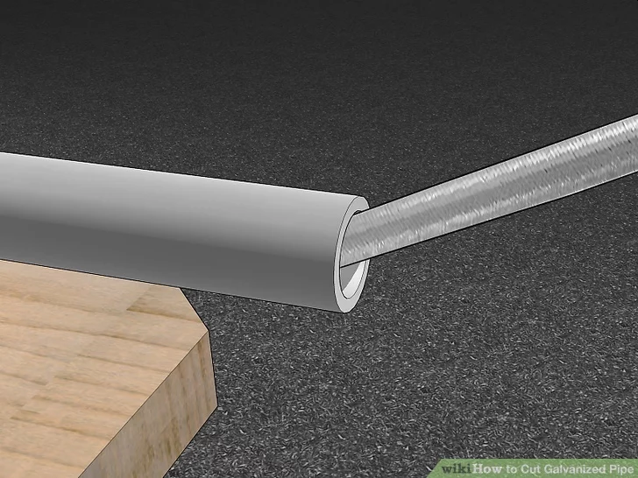
6. Cut, Thread, and Connect Metal Pipe.
Ream the pipe after cutting to remove burrs.
When you cut galvanized pipe with a pipe cutter a burr of steel will be created on the inside edge of the pipe.
To get rid of this, you can file the entire inside edge with a rounded file or you can also use a specialized tool that is made to remove these burrs, which is called a reamer.
Pipe reamers are available at most home improvement and hardware stores.
Alternatively, you can use coarse sandpaper to remove burrs.

Slide 37
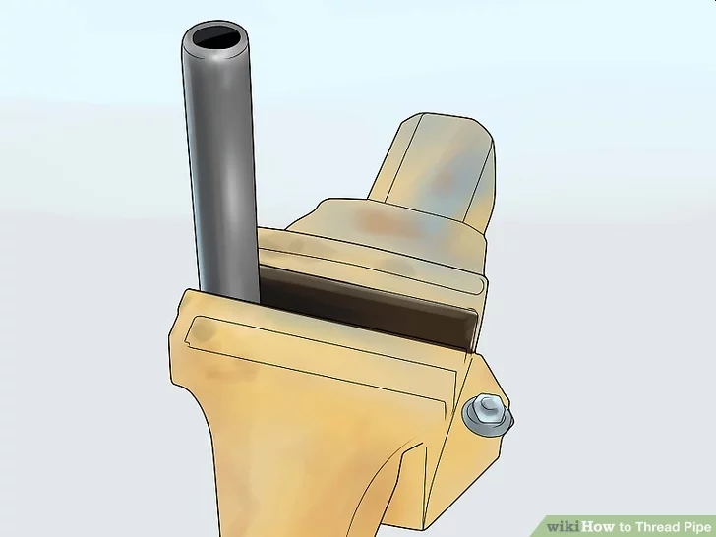
6. Cut, Thread, and Connect Metal Pipe.
Secure the pipe firmly in a vise.
Loosen the jaws of the vise by turning the handle counterclockwise just far enough to fit the pipe between them.
Place the pipe in the vise so the end you want to thread is sticking out, then turn the handle back clockwise to tighten it and secure it in place.

Slide 38
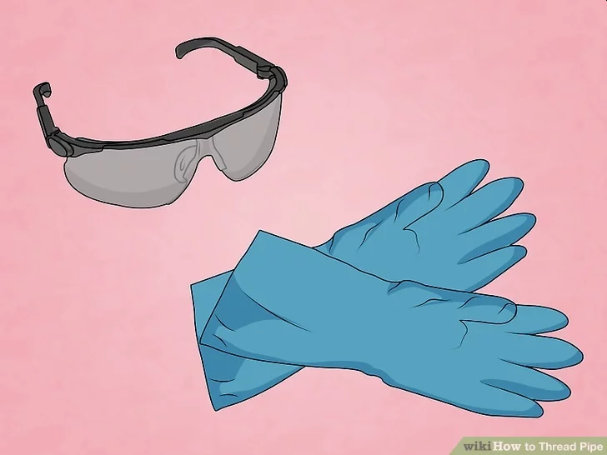
6. Cut, Thread, and Connect Metal Pipe.
Put on work gloves and safety glasses.
These will protect your hands and eyes from any metal slivers and accidental cuts.
It will also keep your hands clean as you lubricate the pipe and pipe threader throughout the process.

Slide 39
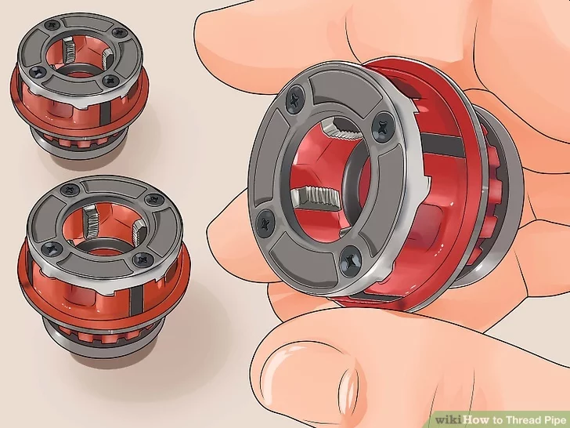
6. Cut, Thread, and Connect Metal Pipe.
Choose a die head based on the pipe’s diameter.
Read the numbers on the different die heads for the ratcheting pipe threader to see what sizes they are.
Select a die head that is of the appropriate size for the pipe you want to add threads to.
A die head is the part of the pipe threader that actually cuts the threads.
Ratcheting pipe threaders typically come with die heads in a few different common diameters.
The face of the die head has numbers on it that indicate the size of pipe it is for.
For example, if it says 1/2 on it, the die head is for threading 1/2-inch piping.

Slide 40
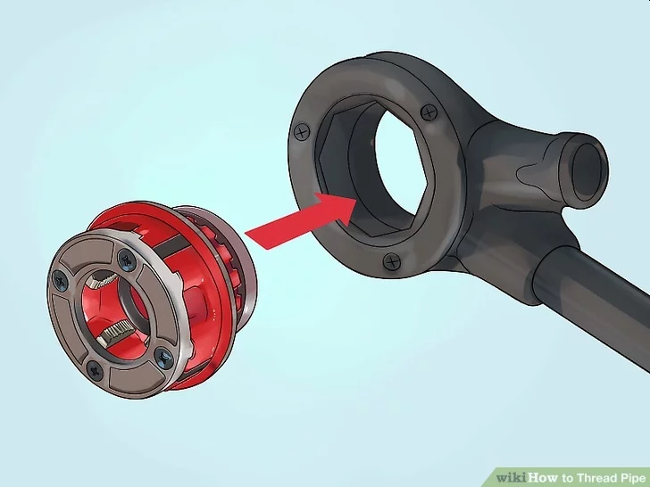
6. Cut, Thread, and Connect Metal Pipe.
Attach the die head to a ratcheting pipe threader handle.
Remove any die head that is already in the handle by pulling it out.
Slide your selected die head into ring at the end of the handle until it snaps all the way into place.
The ratcheting handle is the handle you use to move it around the end of the pipe to cut the threads in it.

Slide 41
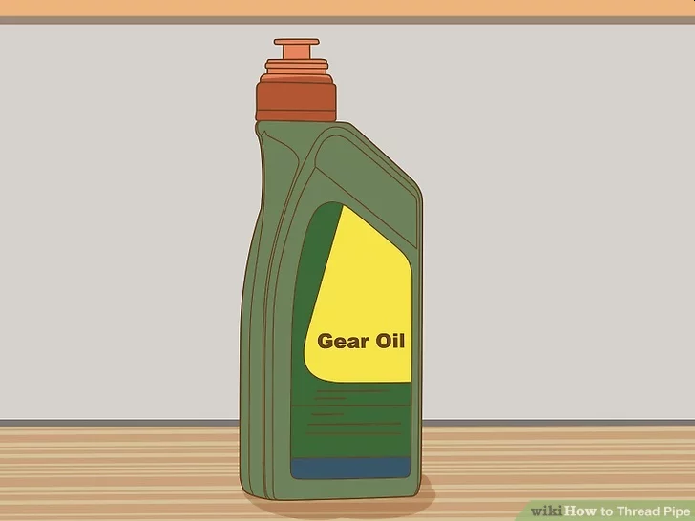
6. Cut, Thread, and Connect Metal Pipe.
Lubricate the end of the pipe with threading oil.
Apply a generous squeeze or two of threading oil to the outside end of the pipe.
This will lubricate it so it’s easier to put the die head on as well as lubricate the teeth of the die head, making it easier to cut the threads.
Don’t worry about applying too much lubricant.
You need a lot to get the job done, so just squirt away until you have completely saturated the outside end of the pipe that you are going to cut threads into.

Slide 42
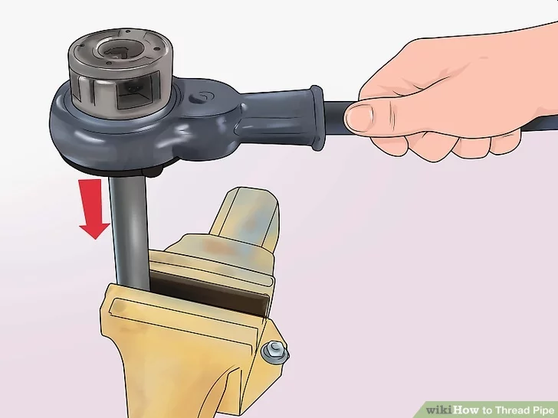
6. Cut, Thread, and Connect Metal Pipe.
Place the die head onto the end of the pipe.
Slide the center hole of the die cutter onto the end of the pipe.
Push it into place as far as it will go.
If it’s hard to get onto the pipe, you can squirt some more threading oil onto the pipe and the middle of the die head to make it easier.

Slide 43
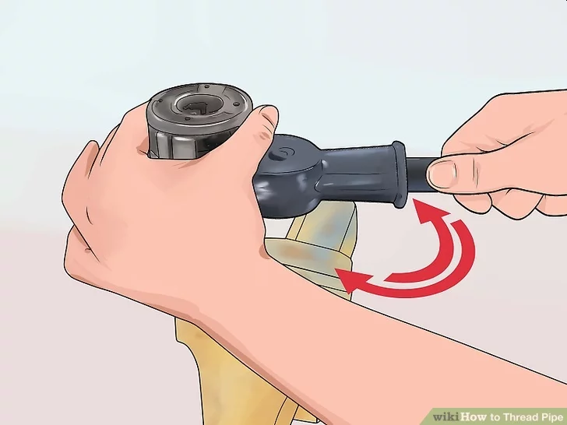
6. Cut, Thread, and Connect Metal Pipe.
Ratchet the handle while applying pressure to the die head to start cutting.
Push against the die head, towards the pipe, with 1 hand.
Ratchet the pipe threader’s handle clockwise with your other hand as far as you can go, maintaining pressure on the die head as you do so to make the teeth start cutting into the pipe.
If you feel resistance as you do this, then you know the teeth are biting into the pipe and starting to cut the threads.
If you don’t feel any resistance, you probably need to push harder on the die head.

Slide 44
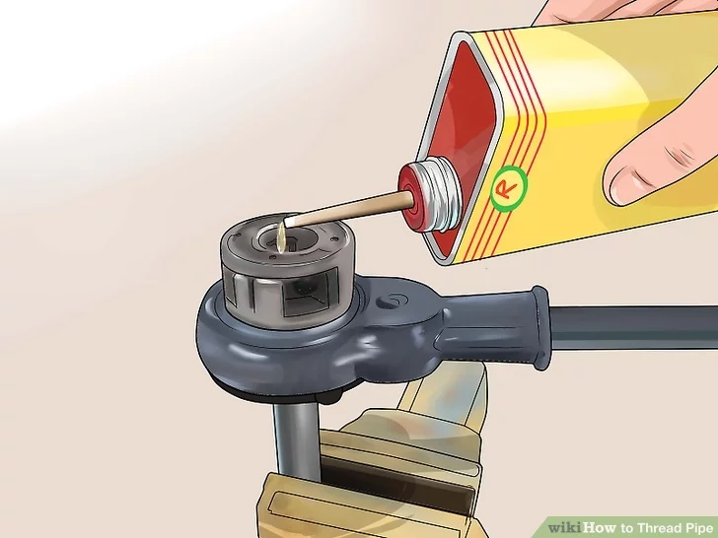
6. Cut, Thread, and Connect Metal Pipe.
Lubricate the exposed teeth of the die head.
Squeeze more threading oil onto all the teeth of the die head that are not yet cutting into the pipe.
This is important to make cutting easier and prevent wear and tear on the teeth.
Don’t be shy about squirting on the threading oil.
You can’t use too much lubricant during this process.

Slide 45
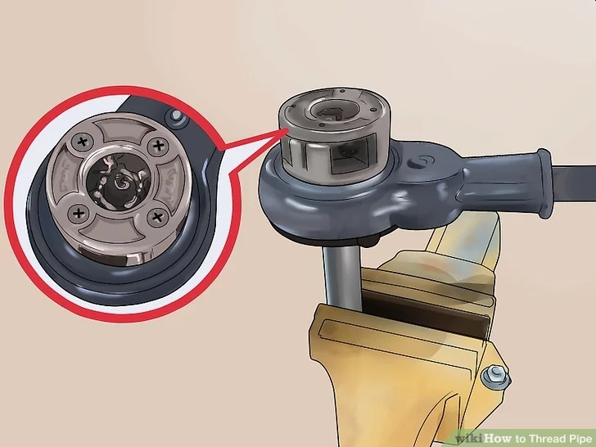
6. Cut, Thread, and Connect Metal Pipe.
Keep ratcheting the handle until all the die head’s teeth have cut into the pipe.
Turn the handle back counterclockwise about 3/4 of the way, then ratchet it clockwise as far as you can go, using your bodyweight to help you turn it.
Repeat this until all the die head’s teeth are around the pipe, which means all the threads have been cut.
If at any point you feel increased resistance while cutting, stop ratcheting and apply more threading oil to the exposed teeth of the die head.

Slide 46
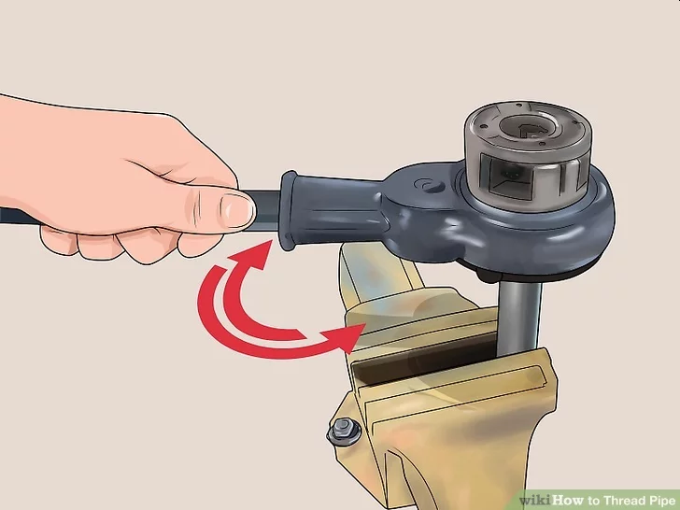
6. Cut, Thread, and Connect Metal Pipe.
Reverse the direction of the ratchet handle and ratchet it off the threads.
Pull up the little black knob next to the die head and turn it to reverse the direction of the ratchet handle.
Ratchet it counterclockwise as far as it will go, then turn it back clockwise about 3/4 of the way, and repeat until you have unscrewed the teeth of the die head from the threads.
When you have unscrewed the die head all the way, you can simply pull it to slide it off the end of the pipe.

Slide 47
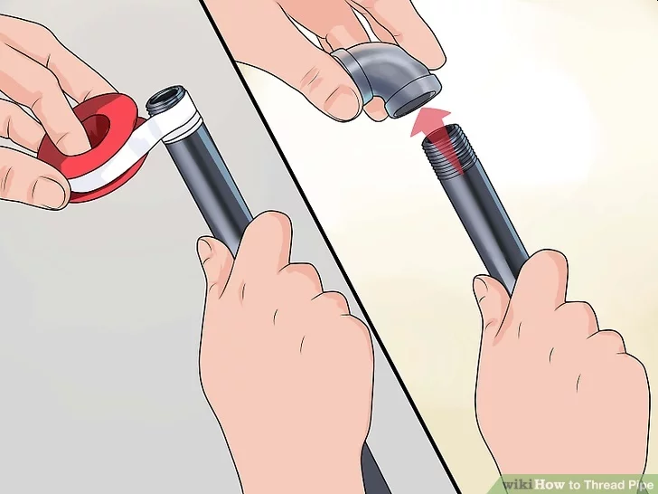
6. Cut, Thread, and Connect Metal Pipe.
Wrap Teflon tape clockwise around the threads at the end of the pipe.
Seal the threads with 2-3 wraps of Teflon tape before you attach any connectors or fittings.
This will ensure a tight, well-sealed connection.
You can also use a liquid pipe thread compound instead of Teflon tape to create a strong seal.

Slide 48
Requirement 7
Under the supervision of a knowledgeable adult, solder three copper tube connections using a gas torch. Include one tee, two straight pieces, and one coupling.

Slide 49
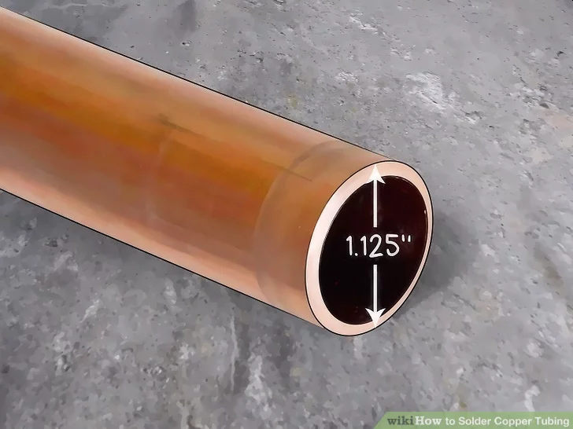
7. Solder Copper Tubing and Fittings
Get copper tubing of appropriate diameter.
Copper tubing used for plumbing piping is available sized nominally, meaning that the outside diameter of the tubing is 1/8" (0.125 inches) larger than its stated size.
In other words, 1" nominal copper tubing measures 1.125" inches in diameter.
If you need to cut the pipe for your project, make sure that you use a tube cutter, clamping the pipe firmly and rotating the cutter around the pipe.
It should take about 8 turns.

Slide 50
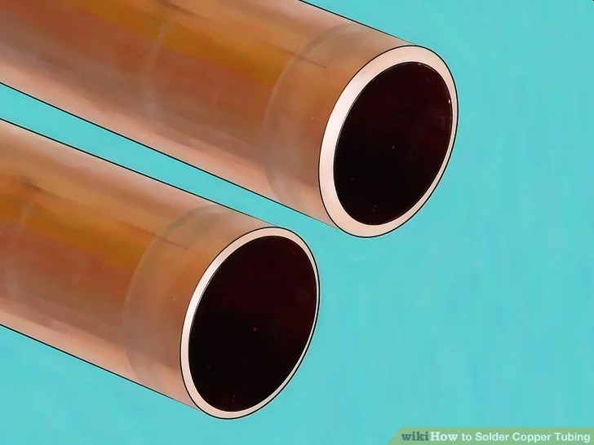
7. Solder Copper Tubing and Fittings
Make sure the tubing is of the proper wall thickness for your project.
Most nominally-sized copper tubing is available in four weights, or wall thicknesses, which is color-coded.
Typically residential projects will involve copper tubing of either Type L or M.
Type L tubing is marked with a blue tag and is typically the most commonly used in commercial/residential installations.
Type M is marked red and has the lightest wall that can be used for a pressurized system.

Slide 51
7. Solder Copper Tubing and Fittings
Get the proper connectors and joints for the system you are building.
For this project, you'll will need one tee, two straight pieces, and one coupling.

Slide 52
7. Solder Copper Tubing and Fittings
Select solder.
For potable water systems, lead-free solid core solder must be used.
It is typically 95/5 (95% tin and 5% antimony), or an alloy of tin and a small amount of copper and/or silver, commonly sold in one pound rolls of 1/8" diameter wire.

Slide 53
7. Solder Copper Tubing and Fittings
Obtain the appropriate solder flux.
This is typically a jelly with a zinc chloride or rosin cleaning component used to cover the cleaned surfaces of the copper to be soldered before assembly and heating.
It is the function of the flux, upon heating, to facilitate further cleaning, exclude atmospheric oxygen, prevent re-oxidation, and to aide in wetting out the solder.

Slide 54
7. Solder Copper Tubing and Fittings
Get a heat source.
Typically, a traditional electric soldering iron won't be hot enough to work with copper tubing.
You'll need a heat source of sufficient output capacity to heat the assembled fittings and tubing to a temperature above that required to melt the filler solder, typically 400 to 500 °F (204 to 260 °C).
For this reason, a propane/air, or acetylene/air torch fitted with a tip of appropriate size is most often used.
Clean, dry cotton rags and a spray bottle full of water will complete the necessary soldering materials.

Slide 55
7. Solder Copper Tubing and Fittings
Remove the copper oxide coating on both the outside of the tubing in the area to be inserted into the fitting, and the inside of the fitting itself.
For this, you can use sandpaper, emery cloth, or specialty devices sold in stores for this purpose.
All copper oxide must be thoroughly removed from both surfaces until they are both completely clean, with no dirt, grease, oil or other impediment which will interfere with the wetting out of the solder.
If you don't, this will result in a leaky joint somewhere down the road.
Any small drips of water through the joint being soldered will prevent the process from working, resulting in a leaky fitting.

Slide 56
7. Solder Copper Tubing and Fittings
Brush the cleaned surfaces with the solder flux as soon as possible after cleaning, and assemble the fitting and tubing.
Apply flux to the inside and outside of the copper tubing.

Slide 57
7. Solder Copper Tubing and Fittings
Light the torch and adjust it so you have a blue flame.
Move the end of the blue flame against the assembled fitting and tubing, moving it all around the components in the area into which solder must be placed.
With constant movement at all times, heat slowly and uniformly while testing the melting point of the solder by touching the tip of the solder wire to the joint.
This will take some practice.
Try holding the flame in your non-dominant hand and the solder in your writing hand.
You are using the flame to heat up the solder and melt it.
You accomplish this by applying the flame to the copper tubing and then touching the solder to the joint.
The heated tubing will draw the melted solder into the joint by capillary action.
Use the flame sparingly.

Slide 58
7. Solder Copper Tubing and Fittings
Move the solder and flame to the side opposite the melted solder, continually feeding small amounts of solder and moving the torch until the solder has circled the fitting.
The solder will seem to run toward the heat.
The purpose is to allow the solder to completely fill the area between the fitting and the tubing by letting it run into the cracks.
On larger fittings, concentrate the heat slightly ahead of the wetted solder to allow this to occur.
Be careful not to overheat the copper.
Keep the torch moving constantly to prevent blackening the copper.
If the joint is overheated and blackened, you'll need to disassemble it and re-clean the pipe, otherwise you'll risk a leaky fitting.

Slide 59
7. Solder Copper Tubing and Fittings
Wipe excess liquid solder from the hot surfaces using a clean, dry cotton rag.
Spray a mist of water on the area soldered to freeze the solder and prevent movement of the joint which would create a leak.

Slide 60
7. Solder Copper Tubing and Fittings
Flush the piping thoroughly.
Use fresh potable water to remove any excess flux, dirt, or loose solder beads inside the tubing after all soldered connections are completed.
This will also help you check for leaks when the job is done.

Slide 61
Requirement 8
Do the following:
Replace a washer in a faucet.
Clean out a sink or lavatory trap.

Slide 62
8a. Replace a Washer in a Faucet
Gather your tools. This way, you'll be prepared for the process. To disassemble your faucet, you'll need the following:
A pair of pliers
An adjustable wrench
A Phillips or flathead screwdriver

Slide 63
8a. Replace a Washer in a Faucet
Plug the drain before beginning the process.
This assures that nothing goes down the drain.
There are a lot of small parts involved when you replace a washer.
They can easily slip out of your hand.
If you don't have a plug for your faucet, simply place a wet rag over the drain.

Slide 64
8a. Replace a Washer in a Faucet
Turn off the water supply.
You do not want water pumping into the faucet while you're disassembling it.
Under your sink, you should see a couple of valves just behind the pipe.
Turn these valves clockwise to the off position.
This will prevent water flow while you work.
Turn the hot and cold faucets on to drain the water between the spigot and the shutoff valve.

Slide 65
8a. Replace a Washer in a Faucet
Remove decorative parts of the faucet.
These are the small caps on top of the faucet that may read "hot" or "cold."
Remove them by inserting a flathead screwdriver just underneath the caps.
Gently pry the cap off.
It's a good idea to wrap the screwdriver tip in a cloth prior to removing the cap to prevent you from chipping or denting your faucet.

Slide 66
8a. Replace a Washer in a Faucet
Take off the faucet's handle.
Some faucets have a small standard screw just underneath the cap, while others have small Allen head screws recessed into the handle.
This is attached to the washer and you must loosen it to remove the handle of your faucet.
Use your Phillips head screwdriver to remove a standard screw, or an Allen wrench to remove an Allen head screw.
Once the screw is removed, gently wiggle the faucet's handle back and forth until it comes loose.
You can then pull out the handle.
Not all faucets have a handle.
If yours does not, you can skip this step but you should still remove your washer's screw.

Slide 67
8a. Replace a Washer in a Faucet
Remove the stem with pliers.
The stem, sometimes called the bonnet, is a small circular piece that sits above the washer's valve that looks something like a donut.
Gently clamp your pliers around the bonnet and pull it out of place.
You may need to wiggle it back and forth to get it loose.
If the stem seems to be stuck, spray it with WD-40, wait 5 minutes, and try again.
Some stems cannot be pulled out with pliers.
If you can easily twist the stem, this means you will need to twist it off instead.
Make sure to place the stem in a safe place as you will need it later when inserting the new washer.

Slide 68
8a. Replace a Washer in a Faucet
Use pliers to take out the old cartridge.
Make sure there are no pieces of rubber or parts of the stem or cartridge left behind.
You now have access to the cylinder-shaped washer contained inside your faucet.
Using your pliers, pull the washer out of place.
There are circular rings, called o-rings, that suction the washer to the faucet.
You will have to grip your pliers tight and pull with a little force to remove the washer.
Note that on some faucets, the rings and seals are built into the cartridge.

Slide 69
8a. Replace a Washer in a Faucet
Determine if you need to replace the O-rings.
Worn out O-rings can cause a faucet to leak as easily as a worn washer can.
If the leak is coming from the base of the faucet, the O-rings are probably worn.
Place a pair of replacement O-rings at the bottom of the faucet before inserting a new washer.

Slide 70
8a. Replace a Washer in a Faucet
If you've never disassembled your faucet before, you may not know what kind of washer you need.
If you don't already have a replacement on hand, take the parts you removed to a hardware store.
Find an exact match for each part.
You may be able to find a repair kit for your particular faucet instead of hunting down the O-rings and washer individually.
If you're unsure where to look at the hardware store, ask an employee to help.

Slide 71
8a. Replace a Washer in a Faucet
You can simply slip the washer in place.
From here, you're basically working in reverse order.
The washer should fit the same as the one you removed.
Make sure you place the washer in the exact same position as the original one.

Slide 72
8a. Replace a Washer in a Faucet
Either screw the stem back on, or place it back over the washer.
Then, place the screw you removed back in place using your Phillips head screwdriver or allen wrench.
Make sure you tighten the screw to get the stem secure.
If you removed the handle, put it back in place before placing the screw back in place.

Slide 73
8a. Replace a Washer in a Faucet
Put the cap back in place by simply snapping the cap back on.
Now, your faucet should no longer leak.
You can turn the water back on and run your faucet.
Once the cap is in place, turn the water valve counter clockwise to switch the faucet back on.

Slide 74
8b. Clean Out a Sink Trap
Locate the sink trap.
Look under your sink and locate a pipe with a J or P-like curve.
This is your sink trap.
The sink trap is located in between the tail pipe and the waste pipe.
The tail pipe is the pipe that connects directly to your sink, and the waste pipe is the pipe that connects to the wall.

Slide 75
8b. Clean Out a Sink Trap
Place a bucket underneath the sink trap.
You can use a regular gallon bucket, or any type of water collecting device like a dishpan.
The bucket will be used to catch any water, dirt, and grime that comes out as you remove the sink trap.

Slide 76
8b. Clean Out a Sink Trap
Begin by loosening the slip joint nuts on each end of the sink trap (on each end of the J or P).
You can do this either manually, using your hands, or you can use a wrench.
Once the joint nuts are loose, continue to untighten them with your hands.
If your sink trap has a decorative or metal finish, then use a strap wrench to loosen the slip joints to prevent scratching.
You can also place duct tape on the parts of the wrench that come into contact with your pipes to prevent scratching.

Slide 77
8b. Clean Out a Sink Trap
As you remove the sink trap, make sure to locate the O-rings.
There should be two; one on each side of the J.
Place them somewhere safe.
The O-rings are used to seal the connection between the sink trap and the tail and waste pipes.
Take a picture of the trap before you remove it to help you reassemble the sink trap correctly.
Clog the waste pipe with a cloth or rag to prevent sewer gases from entering your home.

Slide 78
8b. Clean Out a Sink Trap
Take the sink trap to a separate sink or outside to rinse.
Rinse the trap thoroughly until all the loose dirt and grime are removed.

Slide 79
8b. Clean Out a Sink Trap
Scrub the sink trap with a bottle brush.
You can also use a dishwashing detergent to remove any dirt and grime as you scrub the sink trap.
Scrub the sink trap until all the dirt and grime are removed.
At this point, you can use the bottle brush to scrub and remove any dirt and grime from the end of the tail pipe as well.

Slide 80
8b. Clean Out a Sink Trap
Reassemble the trap by placing the slip joint nuts onto the tail and waste pipes first.
Slip the O-rings back onto the tail and waste pipes.
Then place the sink trap between the tail and waste pipes.
Use your hands to tighten the slip joint nuts over the ends of the sink trap.
Use your wrench to finish tightening the slip joint nuts.
Only tighten the slip joints nuts a quarter turn more.
Try not to tighten them too tight as this can cause your pipes to crack and break.
If there’s rust on the P trap, replace it before it has a chance to leak.

